Slide 1

Parallel GPU Algorithms for Image Processing
Brent Atchison, David Bush, Johnathon Love, Tauseef Aziz

Slide 2

The Motivation
Image processing is a natural fit for data parallel processing
Pixels can be mapped directly to threads
Data can be shared between pixels and threads

Slide 3

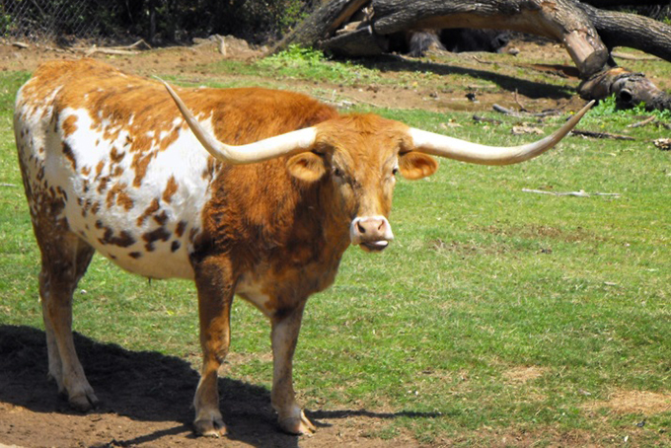

Gaussian Image Blur Filter
Reduces the noise and detail in an image
Involves convolving with a Gaussian Function
CPU Runtime: 0.102 s
GPU Runtime: 35.3 μs
Before:
After:

Slide 4
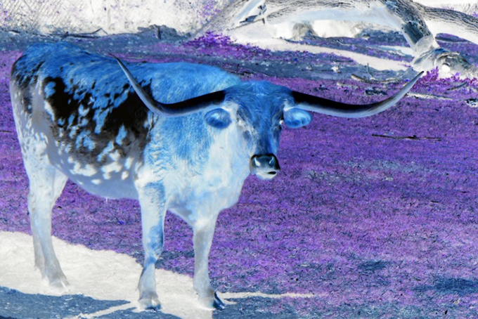
Negative Image Filter
Finds the opposite pixel values
Operates individually on each pixel
CPU Runtime: 3.49 ms
GPU Runtime: 38.4 μs
Before:
After:

Slide 5
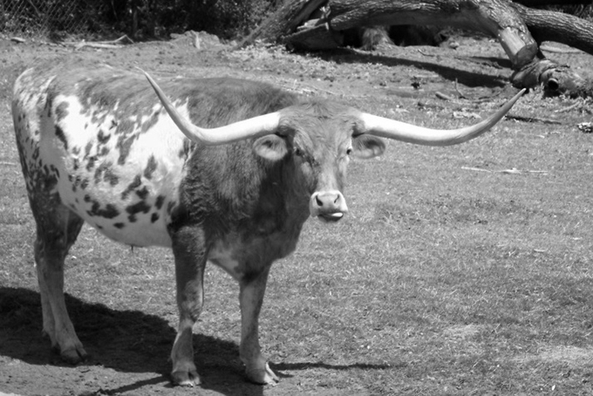
Greyscale Image Filter
Measures light in each pixel
Reconstructs image using the intensity found for each pixel
CPU Runtime: 3.99 ms
GPU Runtime: 43.0 μs
Before:
After:

Slide 6
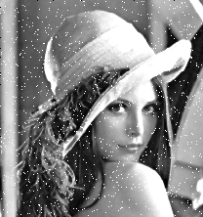

Median Image Filter
Removes noise from an image while preserving the edges
Examines neighboring pixels to determine new pixel value
CPU Runtime: 29.2 ms
GPU Runtime: 29.0 μs
Before:
After:

Slide 7

The Bottom Line
Gaussian Image Blur: 289,000.0% speedup
Negative Image Filter: 9,090.0% speedup
Greyscale Image Filter: 9,280.0% speedup
Median Image Filter: 100,700.0% speedup

Slide 8
Thanks!
Any questions ?
You can find our repo at
https://github.com/atchisonbrent/361C_Image_Processing

